Slide 1
CGH Assessment: Within the Context of Cervical Spine Examination

Slide 2
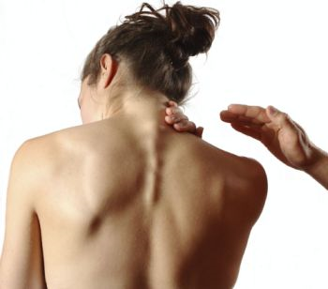
PT Appropriate
Mobility
Centralization
Pain Control
Conditioning
Reduce Headache
Consultation
Referral
First Level Classification
Notes:
2

Slide 3
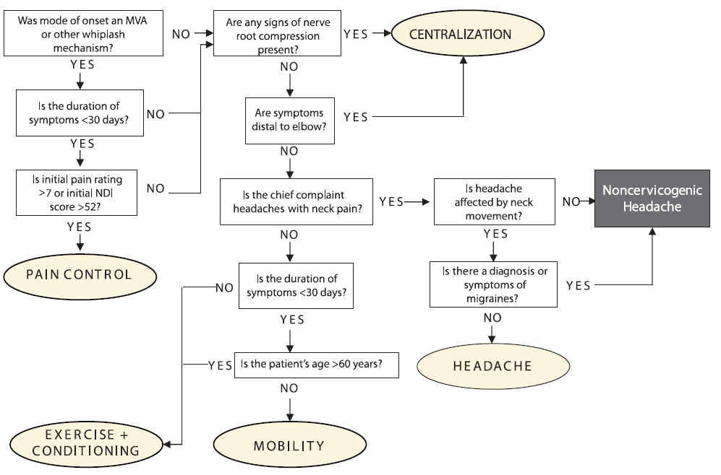
Cervical Treatment Based Classification
Fritz & Brennan (2007)

Slide 4
Physical Examination Objectives
Identify cervical contribution to HA’s
Is there a comparable sign
Identify Impairments that may be directly or indirectly contributing to HA’s
Develop Prognosis
SINSS, Contributing factors, Psychosocial Issues

Slide 5
History – Important Questions
Age of onset and duration
MOI- history of trauma including MVA, manipulations, falls, quick mvts, pregnancy.
Nature and quality of HA’s (unilateral, bilateral, throbbing, pulsating, constant, intermittent, duration)
Associated Symptoms – nausea, photo or phonobia, “5 D’s”
Aggravating and alleviating factors
Posture, Stress, Response to medication.
How are symptoms changing
Previous Treatments

Slide 6
Assessment & Biomechanics of the Upper Cervical Spine

Slide 7
Assessment & Mechanics of Upper Cervical Spine
C0-C1
Flexion/Extension
35 degrees ;10 flexion/25 extension (Sizer 2005)
Axis through External Auditory Meati
Occipital condyles roll in same direction, glide opposite (1,2)
Unilateral limitations in flexion result in deviation to opposite side (3)
Limitation in R OA flexion, chin will deviate to left with OA flexion.
Unilateral limitations in extension result in deviation to same
Limitation in R OA extension, head will tilt to the right
Greater amounts of Upper cervical flexion achieved in Cervical retraction, extension with protraction.

Slide 8
Assessment & Mechanics of Upper Cervical Spine
C0-C1
Side-Bending
Axis through the nose
Occipital condyles roll to same side and slide opposite
Obligatory motion of the Atlas* (Paris & Sizer)
Translate to same side and rotate opposite ( SBR, atlas will translate right and rotate left).
Obligatory motion at C2-3*
Rotation to same side as SB (due to Alar ligament)
OA will not SB if C2 cannot rotate on C3 to same side. (1)
C2-3 “Keystone to Upper Cervical motion” (1)

Slide 9
Assessment & Mechanics of Upper Cervical Spine
C1-C2
40-45 degrees rotation to each side
With right rotation the right C1 facets slides posterior to C2 facet and the left C1 facet slides anterior to left C2 facet
The occiput will SB opposite direction of rotation (1)
Absence of this will produce an obvious ipsilateral SB with rotation

Slide 10
ASSESSMENT LAB - Sitting
Observe Posture
AROM
Cervical physiologic
AA Rotation
OA SB
Cranial Nerves
Palpation of Sub-Occipital Triangle
Upper Cervical Ligamentous Testing
Transverse
Alar

Slide 11
Forward Head Posture
Subcranial Posterior Rotation & Anterior head Translation leads to a decrease in Craniovertebral Angle
O/A and AA Functional spaces Altered
Compression of subcranial structures including the vertebral arteries and their sympathetic nerves, the first two cervical nerves, and soft tissue. (1)
Hypomobility about the upper cervical spine and upper thoracic spine (1,2)
Mid-Cervical hypermobility (3)
Alterations in muscle length tension relationships and muscle function (Upper Cross Syndrome) (3)

Slide 12
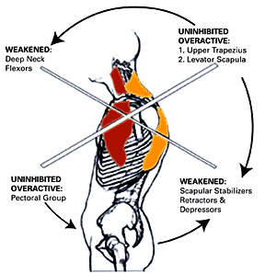
Observation / Postural Examination
View patient’s posture from the side
Assess:
Forward head posture
Shoulder carriage
Typical patterns include:
Sub-Cranial Posterior Rot.
Flexed (rounded) T1-T2
Extended (flat) T3-T7
Flexed (rounded) T8-T12

Slide 13
Forward Head Posture – Upper Cross Syndrome (3)
Weakened Muscles Shortened Muscles
Deep Cervical Flexors Sub-Occipitals
Lower and Mid Trapezius Upper Trapezius
Serratus Anterior Pectorals

Slide 14
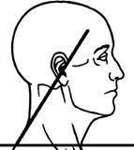
Craniovertebral Angle – Fernández-de-las-Peñas C et al (2007)
Measured Craniovertebral Angle by measuring the angle formed by horizontal line through C7 and a line form C7 to the Tragus of the Ear.
Smaller angle associated with CTTH (4,5)

Slide 15
Forward Head Posture - Assessment
Visual Observation
Sitting
Manubrium to Mentonian Symphysis (lowest point on mandible) to Malar Bone
Position of SCM (60 deg angle) (structure changes function)
Palpate C0-C2 space
CV Angle
Ability to correct
Standing
Head to Wall (measure).

Slide 16
References
Brame M. Headaches and the Upper Cervical Spine. Course Handout. North American Seminars 2005
CranioMandibular Sytem. On-Line Course Material. University of St. Augustine for Health sciences 2010.
Lau et al. Clinical measurement of craniovertebral angle by electronic head posture instrument: A test of reliability and validity. Manual Therapy 2009; 14:363–368
Moore M. Upper Crossed Syndrome and its Relationship to Cervicogenic Headache. Journal of Manipulative and Physiological Therapeutics 2004;27:414-20
Fernandez-de-las-Penas C. Performance of the Craniocervical Flexion Test, Forward Head Posture, and Headache Clinical Parameters in Patients With Chronic Tension-Type Headache: A Pilot Study. JOSPT 2007;37(2):33-39

Slide 17
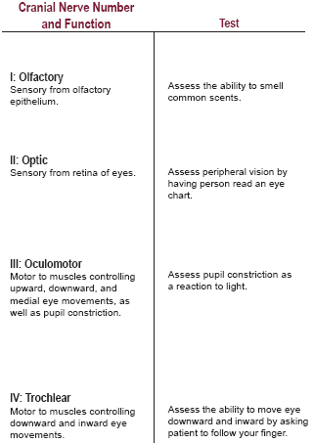
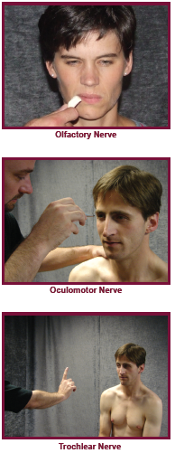
Cranial Nerve Exam

Slide 18
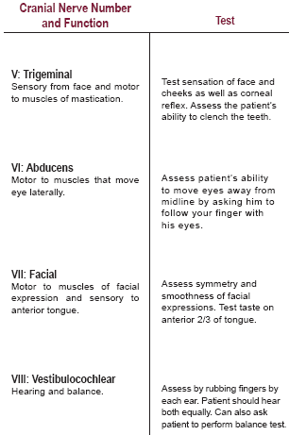
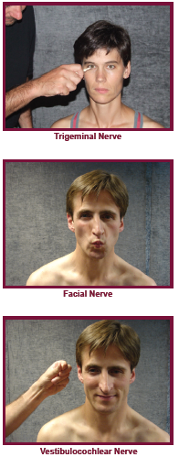
Cranial Nerve Exam

Slide 19
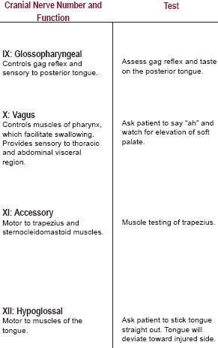
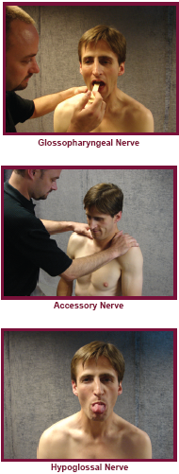
Cranial Nerve Exam

Slide 20
Upper Cervical Ligamentous Testing

Slide 21
Upper Cervical Ligamentous Testing
Transverse Ligament (1)
Prevents separation of C1 and C2
Prevents tipping of the Dens into brainstem and spinal cord
Alar Ligament
Assists Transverse Ligament
Taught in extension, SB and ipsilateral rotation
Responsible for coupled motions

Slide 22
Upper Cervical Ligamentous Testing – Sharp Purser
Purpose: Position of Atlas and Dens (Transverse Ligament)
Patient: Sitting
Technique: The palm of one hand is placed on the patient’s forehead while the spinous process of the axis is held by a pinch grip of th opposite hand. Then the head and neck are the gently
flexed. Through palmar pressure on the forehead, the occiput and atlas are translated posteriorly.
Positive: Decrease symptoms or clunk.
Mintken P et al . JOSPT 2008;38(8):465-475

Slide 23
Upper Cervical Ligamentous Testing – Alar Ligament
Patient seated in upright posture
Stand at patients side and achieve pincher grip of SP of C2 (you many need to flex cervical spine if patient has significant FH)
Side-bend head to one side
Test: You should feel an obilgatory movement of the SP of C2 moving away from the side the side –bending is occurring. This is due to obligatory rotation to same side with intact Alar Ligament.

Slide 24
Palpation of Sub-Occipital Triangle
Base of Occiput to TP of Atlas
TP of Atlas to SP of C2
C2 to Base of Occiput
Note texture of tissue
and provocation.

Slide 25
ASSESSMENT LAB - Supine
PROM
OA flexion , extension and SB
AA Rotation
with flexion and/or SB
C2-3 Accessory Glides
General Upper Thoracic (PA)
Palpation (length)
Trapezius
SCM
Sub-occipitals
Splenius
Muscle Performance (Motor Control)
DCF with or without biofeedback

Slide 26
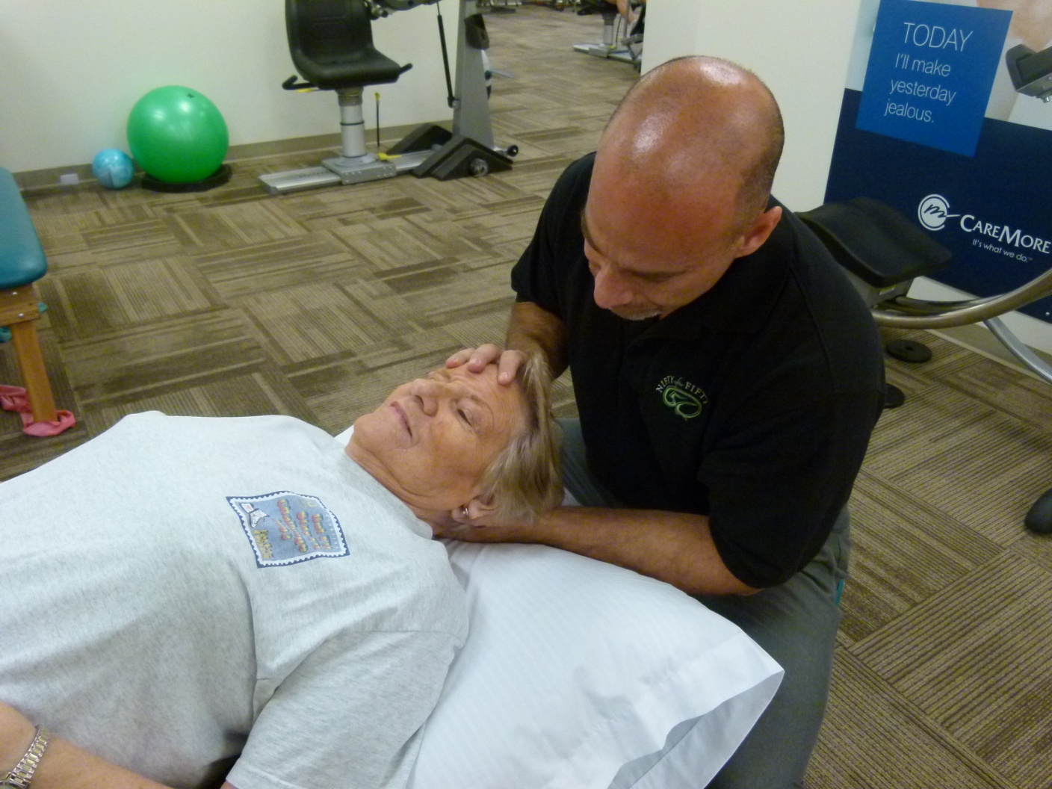
OA Extension and Flexion
Patient supine with cervical spine in neutral. Cradle head with both hands with thumbs resting on temporal region. Gently nod occiput forward and backward around a transverse axis through the External Auditory Meati. Bias flexion to the right or left by rotating head 20-30 degrees in same direction. Alternate technique is to place one hand on forehead and use a coupling motion with both hands to induce flexion/extension
Cradle patients head with both hands. Use the radial border of your second phalanx to lift the occiput anteriorly. Bias extension towards the right by lifting up on the left, assessing the left side.

Slide 27
Upper Cervical Ligamentous Testing – Anterior Shear Test
Purpose: Transverse Ligament
Patient: Supine
Position: Head is supported with second index fingers resting between occiput and C2
Technique: Head and C1 are lifted anteriorly
Positive: Produces nystagmus, paresthesias of lips, hands toes, increase patients symptoms. Note end feel
Mintken P et al . JOSPT 2008;38(8):465-475.

Slide 28
OA - Sidebending
Patient supine with head in neutral.
Grasp head with both hands with hand/thumb on side where SB to occur on mandible.
Use coupled motion to induce SB through subcranial region.
Can use abdomen to perform comfortable axial load to stabilize cervical spine.
10-15 degrees is normal

Slide 29
AA Rotation with Flexion
Cervical Spine is fully flexed with patients head supported by clinicians abdomen.
Cervical Spine is rotated fully to the both sides.
Note range of motion, end-feel and patient response.

Slide 30
AA Rotation with SB
Cervical spine is resting on pillow in neutral flexion/extension.
SB to one side to first barrier. Rotate head gently to opposite side
Important: No more than 40-45 degrees should be available. Assess range, quality and pain. Do not lose SB

Slide 31
Palpation and Uglide of C2-3 (R)
Patient supine with heads resting on pillow
Palpate the articular pillar of C2 with your finger tips and slide right index finger down along pillar to approximate the middle phalanx.
Rotate head and neck minimally to the right without feeling motion takng palce at C2-3. Add slight SB to left using mostly your trunk
Use your contact point to provide a “lifting” motion in a 45 degree plane toward patients left eye

Slide 32
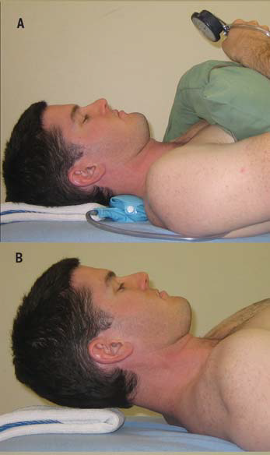
Motor Performance of the DCF
O’Leary S et al 2009
With Biofeedback:
Cervical Spine is in neutral. Inflate cuff to 20 mm hg. Instruct patient to perform nodding movement (yes) to 22 mm hg for 10 secs. Provide 10 sec rest and move up to 30 in increments of 2 if patient able to perform. Should achieve 26-30 mm hg.
Without Biofeedback:
Retract neck and perform chin tuck. Lift head one inch. Maintain tucked chin and hold head up.
Neck pain: 24 Without: 38
Childs JD et al 2008

Slide 33
Assessment Lab - Prone
Unilateral PA’s
C0-1
C2-3
C1-2
T2-4 Apophyseal and CT joints
Tip: In these techniques utilize shoulder adductors and trunk to grade force while relaxing the thumbs.

Slide 34
C2-3 Unilateral PA
Head and neck are in neutral. Take up slack in soft tissue. PA is applied to the articular pillar of C2 assessing further rotation of C1 on C2. Using arms (pectorals) and trunk to impart pressure which is mild. Note resistance and reproduction of pain.
Without rotation assess C2-3. Can be a treatment technique with graded oscillations

Slide 35
C1-C2/ Unilateral PA
Head is rotated 30 degrees to the side tested. Take up slack in soft tissue. PA is applied to the articular pillar of C2 assessing further rotation of C1 on C2. Using arms (pectorals) and trunk to impart pressure which is mild. Note resistance and reproduction of pain.
Can be a treatment technique with graded oscillations.
With Permission – Fearonphysicaltherapy.com

Slide 36
References
Sizer PS et al. Diagnosis and Management of Cervicogenic Headache. Tuitorial. Pain Practice 2005; 5(3): 255-274
Paris SV. S3 Seminar manual. University of St. Augustine. Patris, Inc 4th Edition 2000.
Cervico-Thoracic Integration. Course Manual. Institute of Physical Art 2002.

